Slide 1
Combat HUD

Slide 2


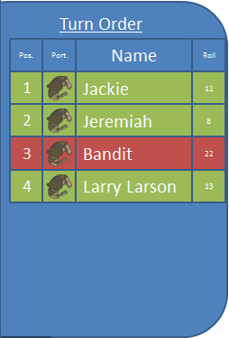




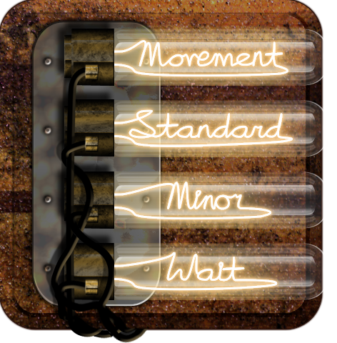


Vincent Vanguard
Health 6/6
Composure 4/4
C
K
I
!
!
End Turn
T
M
Console Log
TAB

Slide 3



Vincent Vanguard
Health 6/6
Composure 4/4
C
K
I
End Turn
T
M
!
!
Console Log
TAB

Slide 4



Vincent Vanguard
Health 6/6
Composure 4/4
C
K
I
End Turn
T
M
!
!
Console Log
TAB

Slide 5
Character Sheet

Slide 6
Map

Slide 8
Options

Slide 9
Options
Gameplay
Save
Load
Video
Quit to Main Menu
Quit to Desktop
Close
Audio

Slide 10
Game Over

Slide 11
Game Over
Load Last Save
Load
Quit to Main Menu
Quit to Desktop

